Slide 1

The National University of Computer and Emerging Sciences
Machine Learning Overview
Deep Learning for Perception
Dr. Noshina Tariq
Department of Computer Science

Slide 2
Goals
Review of Previous Lecture
Today’s Lecture
Machine Learning Overview
Linear models
Loss functions, linear regression, gradient descent, overfitting, underfitting generalization, regularization, cross-validation

Slide 3
Recap of Previous Lecture

Slide 4
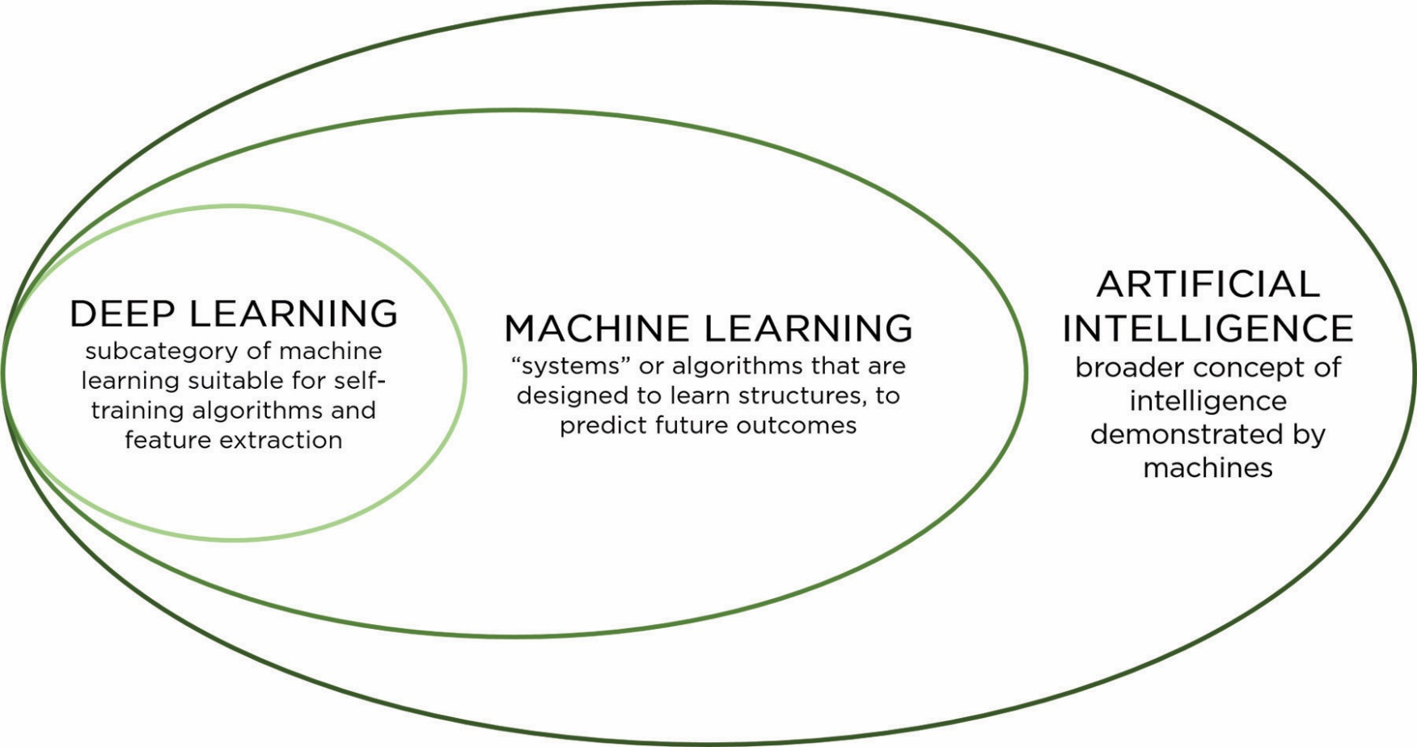
Deep Learning
Specific subfield of machine learning.
The deep in deep learning is not a reference to any kind of deeper understanding achieved by the approach or method.

Slide 5
Machine Learning
Machine learning algorithms are complex
A machine learning algorithm is an algorithm that is able to learn from data.
ML algorithms combines various algorithm components, such as an optimization algorithm, a cost function, a model, and a dataset, to build a machine learning algorithm.

Slide 6
Hyperparameters vs Parameters
Hyperparameters and parameters are both essential components of a machine learning model.
Have different purposes and distinct characteristics.
Parameters:
Parameters are the internal variables of a machine learning model that are learned during the training process.
Model adjusts to fit the training data to understand the relationships in data.
For example, in a linear regression model, the parameters are the coefficients assigned to each feature, and in a neural network, the parameters include the weights and biases of the network's neurons.
Keep updating these parameters iteratively to minimize a chosen loss function

Slide 7
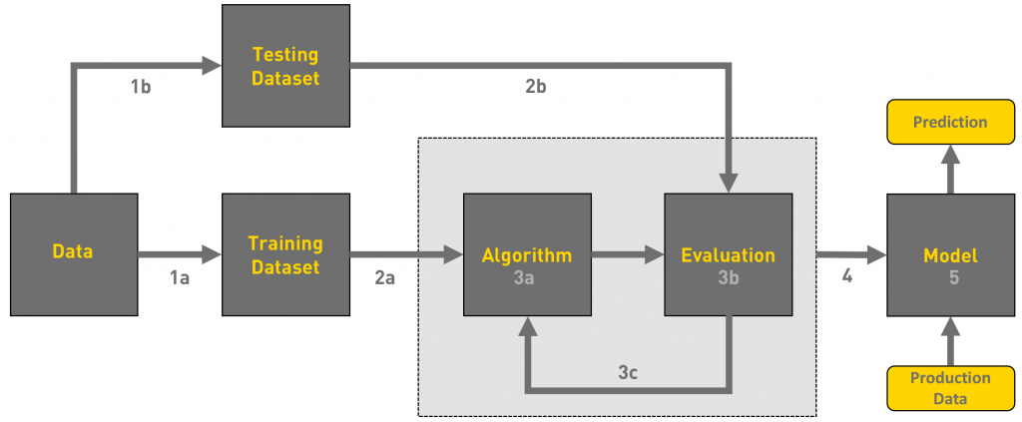
Workflow of ML tasks

Slide 8
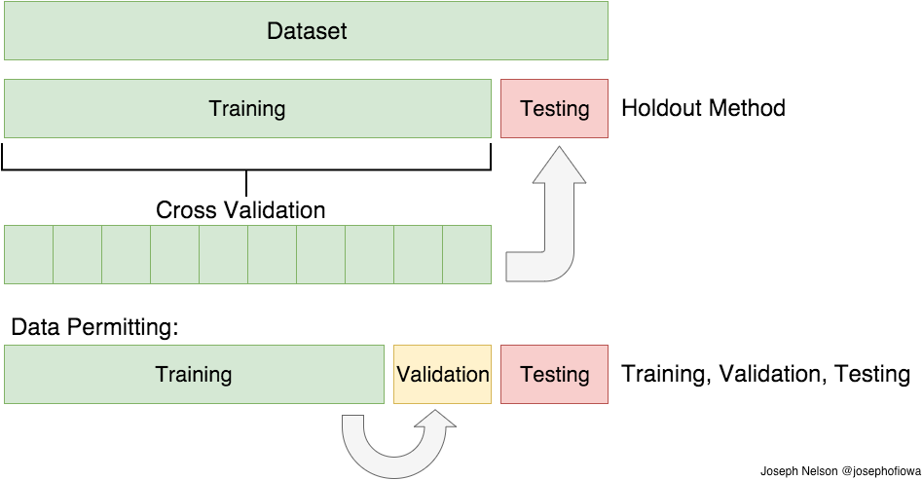
Training, Validation and Testing Data

Slide 9
Train, Test and Evaluate model
Cross-Validation
Set aside some portion of the data for validation and Train on rest of it.
LOOCV (Leave One Out Cross Validation)
Perform training on the whole training data set but leaves only one sample for validation
K-Fold Cross Validation
The data-set into split into k subsets(folds)
Perform training on the all the subsets but leave one(k-1)
Iterate for all folds

Slide 10
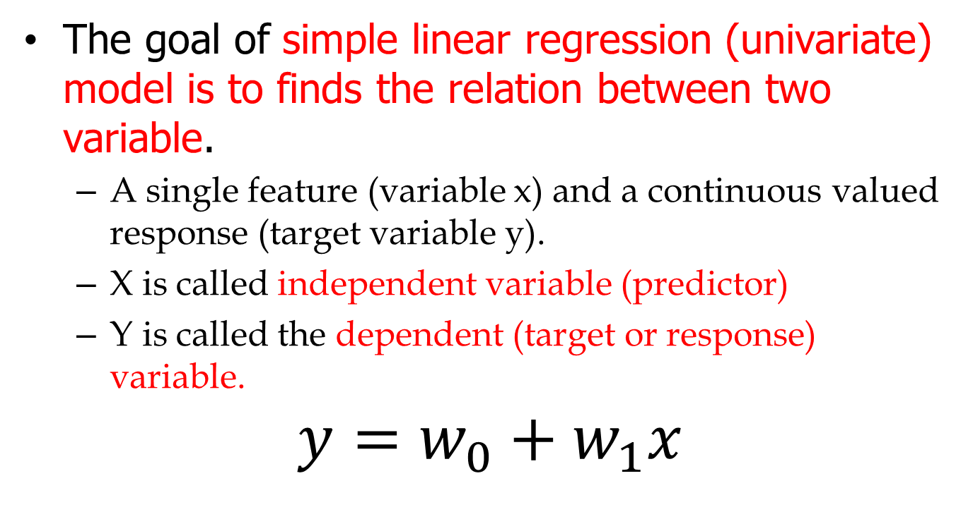
Linear regression
The goal of simple linear regression (univariate) model is to finds the relation between two variable.
A single feature (variable x) and a continuous valued response (target variable y).
X is called independent variable (predictor)
Y is called the dependent (target or response) variable.
$$y=w_{0}+w_{1}x$$

Slide 11
Today’s Lecture

Slide 12
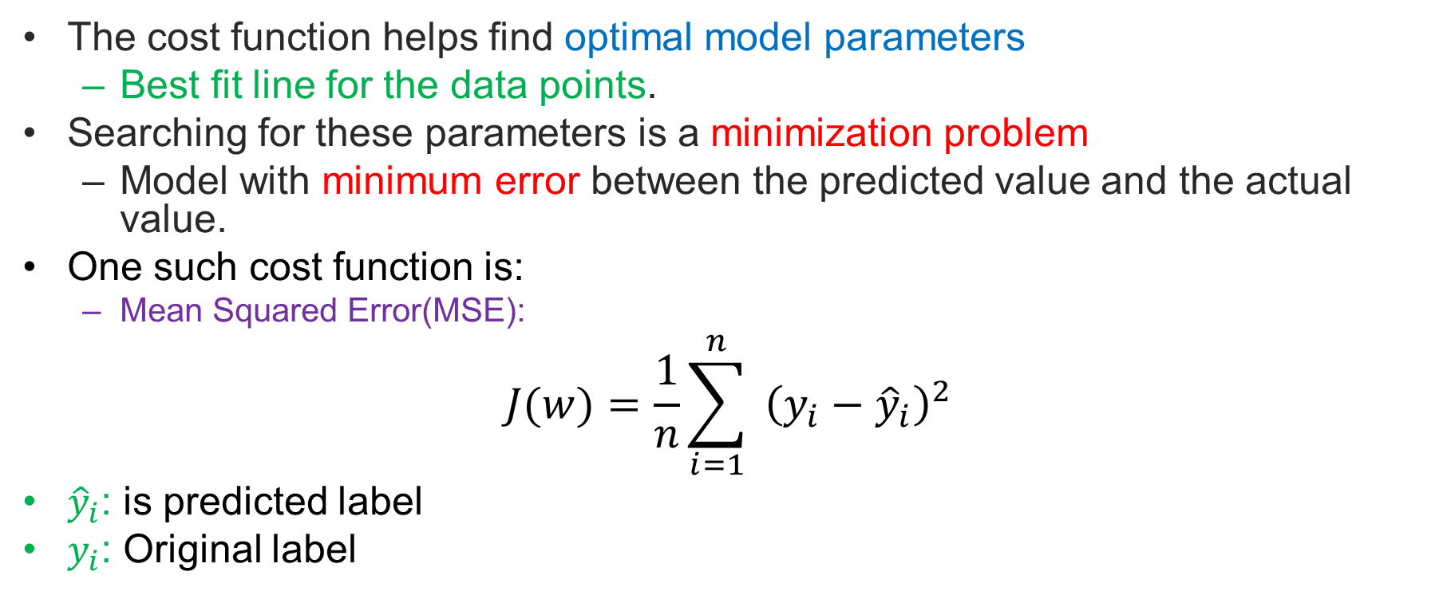
Cost function
The cost function helps find optimal model parameters
Best fit line for the data points.
Searching for these parameters is a minimization problem
Model with minimum error between the predicted value and the actual value.
One such cost function is:
Mean Squared Error(MSE):
$$J(w)=\frac{1}{n}\sum_{i=1}^{n}{ }{\left(y_{i}−{\hat{y}}_{i}\right)}^{2}$$
${\hat{y}}_{i}$: is predicted label
$y_{i}$: Original label

Slide 13
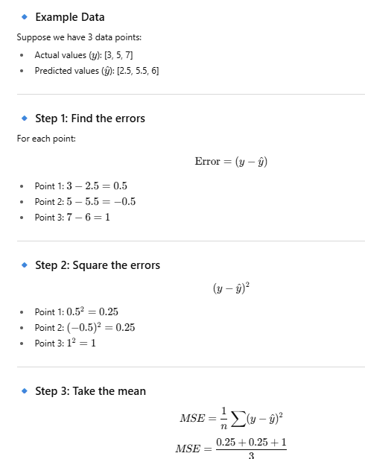

Slide 14
Thought Provoking Question
How can we evaluate the performance on the test data set when we can observe only the training set?

Slide 15
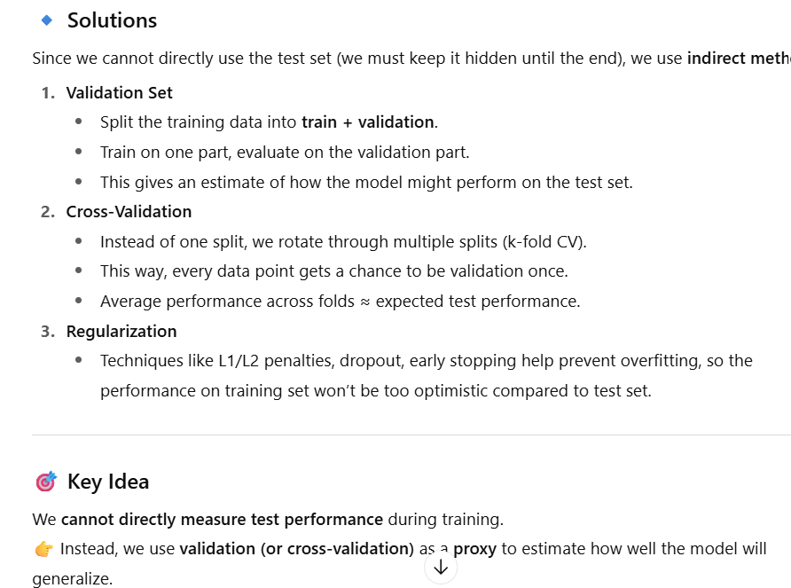

Slide 16
Machine Learning
We believe that the data-generating process is similar for both training and testing data.
E.g. Images are taken by the same sensor
We assume that the examples in each dataset are independent from each other, and that the training set and test set are identically distributed
When we say training and test data are IID:
Independent → One sample (e.g., a student’s exam score) doesn’t influence another student’s score.
Identically Distributed → Both training and test data are drawn from the same source/pattern (e.g., same exam style, same grading system).
One option could be to randomly select the training and testing data
Notes:
🔹 Data-Generating Process
In real life, there is some unknown process that generates the data (e.g., exam scores depending on study hours, or house prices depending on size).
We only see samples from this process (training and test sets).
🔹 Assumption: Training & Test are IID
IID = Independent and Identically Distributed
Identically Distributed → both training and test data come from the same distribution.
Independent → each data point is sampled independently (not influenced by the others).
This assumption allows us to say: 👉 If the model performs well on the training data (or validation), it is likely to also perform well on the test data.
🔹 Why important?
If training and test data come from different distributions (e.g., training on cats & dogs, testing on lions & tigers), the model will fail.
This is called a distribution shift or data drift.
🎯 Simple Example
Suppose we want to predict student exam scores.
Training data = students from one school
Test data = students from the same school, same exam style → likely IID ✅
Test data = students from a different country with different exam system → not IID ❌

Slide 17
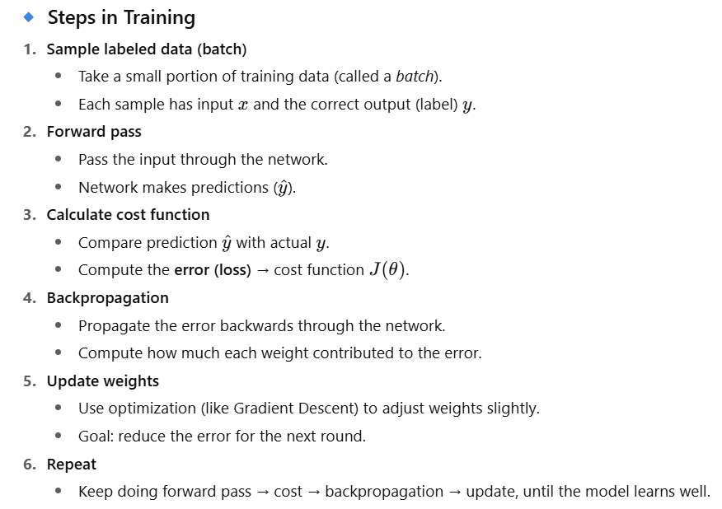
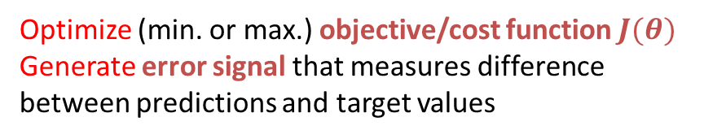
Training
Sample labeled data
(batch)
Forward it through the network, get predictions
Back-propagate the errors
Update the network weights
Optimize (min. or max.) objective/cost function $J(θ)$
Generate error signal that measures difference between predictions and target values
https://medium.com/@ramrajchandradevan/the-evolution-of-gradient-descend-optimization-algorithm-4106a6702d39

Slide 18
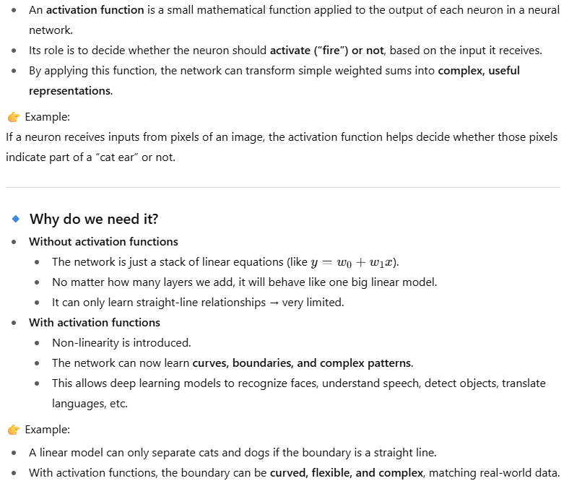
Activation functions

Slide 19
Activation Function | Pros | Cons | Typical Use
Sigmoid | Smooth, interpretable as probability | Vanishing gradients, slow training | Binary classification (output layer)
Tanh | Centered at 0, stronger gradients than sigmoid | Still suffers vanishing gradient | Hidden layers in shallow nets
ReLU | Simple, fast, avoids vanishing gradient | “Dying ReLU” (neurons stuck at 0) | Most hidden layers in deep nets
Leaky ReLU | Fixes dying ReLU problem | Small negative slope may add noise | Deep nets (hidden layers)
Softmax | Converts outputs into probabilities | Sensitive to outliers | Multi-class classification (output layer)
ELU (Exponential Linear Unit) | Smooth, fixes dying ReLU, mean ~0 | Slightly slower to compute | Deep CNNs, RNNs

Slide 20
Gradient Descent
Gradient descent is an optimization algorithm
Its goal: search for the best parameter values that minimize the cost function.
It helps for searching for the optimal model parameters
Update parameters according to the gradient values.
A gradient measures how much the output of a function changes if you change the parameter values.
The gradient tells us: “how much the output (error) will change if we slightly change a parameter (weight).”It’s basically the slope of the cost function with respect to each parameter.
Large gradient → big change needed, Small gradient → small adjustment.

Slide 21
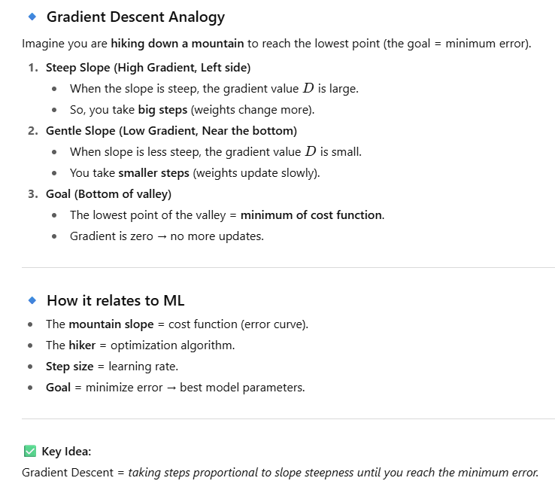
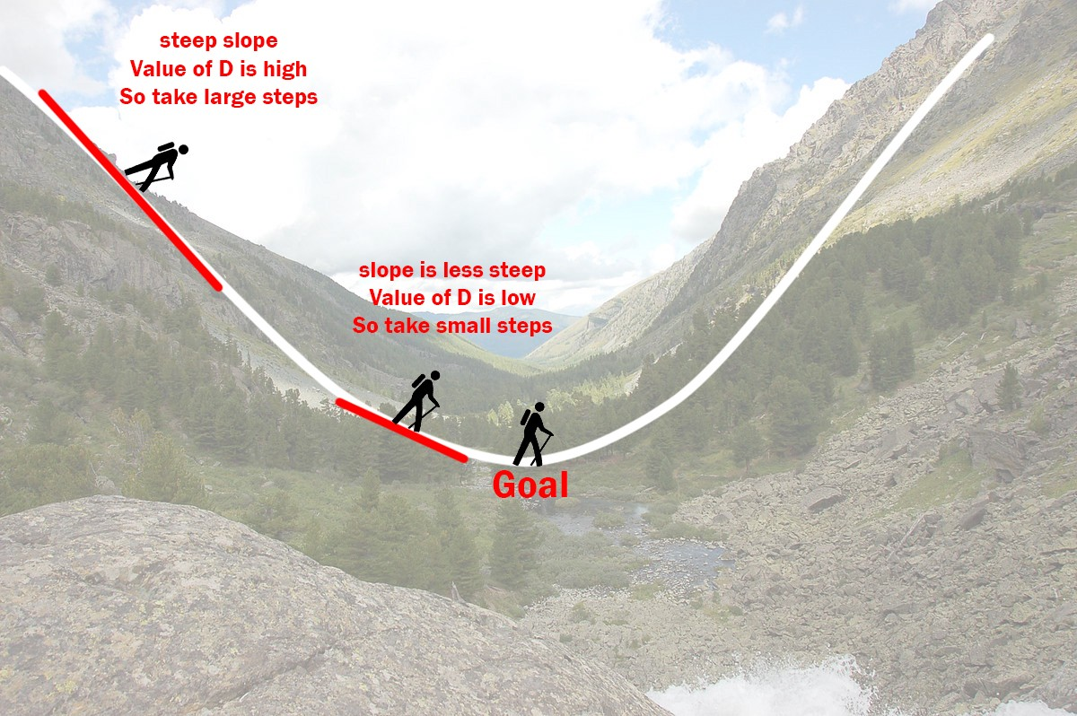
Gradient Descent

Slide 22
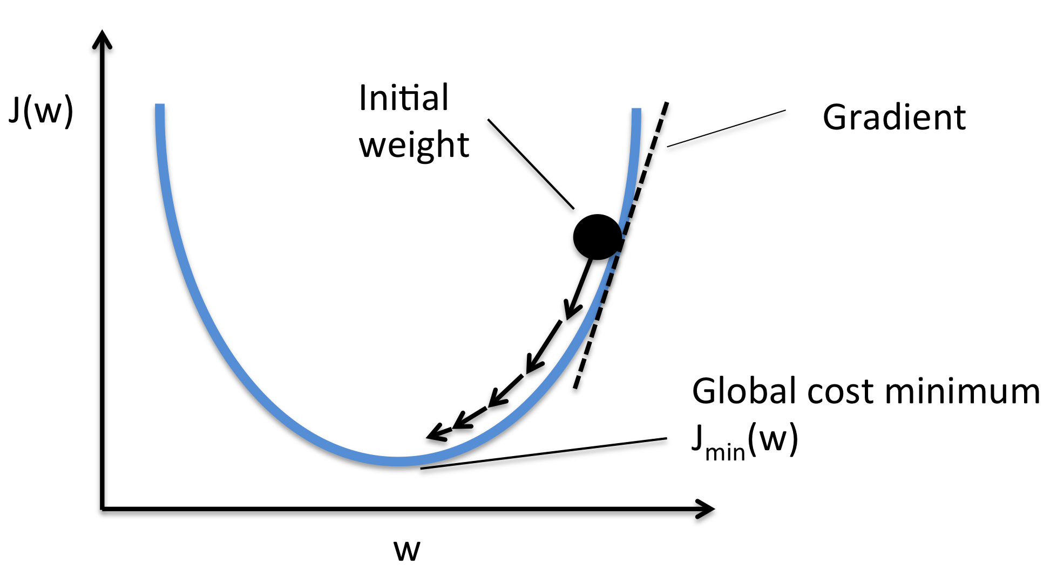
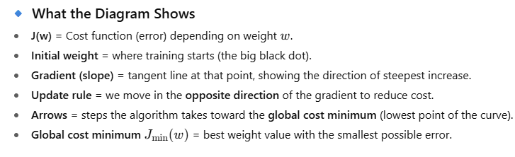
Gradient Descent

Slide 23
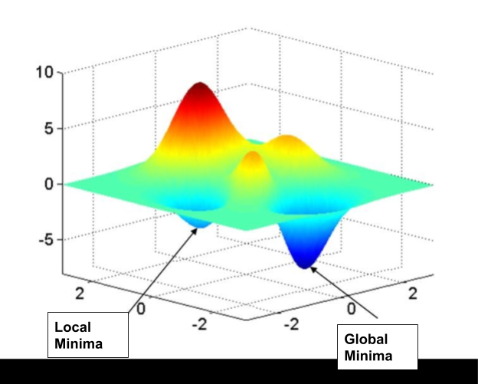
Gradient Descent

Slide 24
Offline and online Learning
Batch learning
The model must be trained using all the available training data.
Take time and lot of computing resources
First the system is trained, and then it is deployed into production environment
No more learning
This is called offline learning.

Slide 25
Offline and online Learning
Online learning
The system is trained incrementally by feeding data instances sequentially
Can be feed data individually or in small groups called minibatches.
Can perform learning fast
The system can learn about new data on the fly
A model is trained and launched into production, and then it keeps learning as new data comes in.

Slide 26
References
Chapter 5, Deep learning book

Slide 27
Thank You ☺

